Slide 1
Meet Mrs. Rosengard Language Arts – 6A

Slide 2
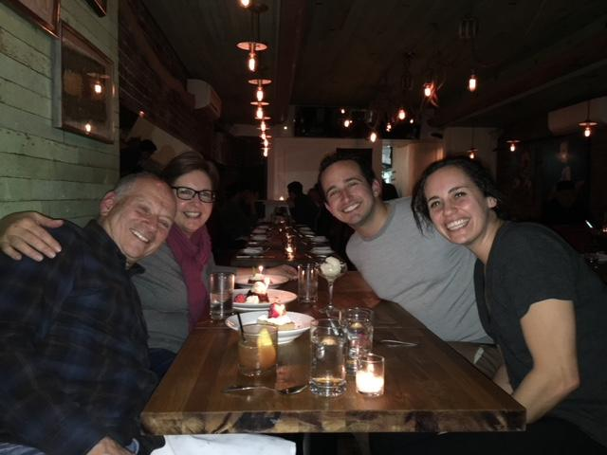
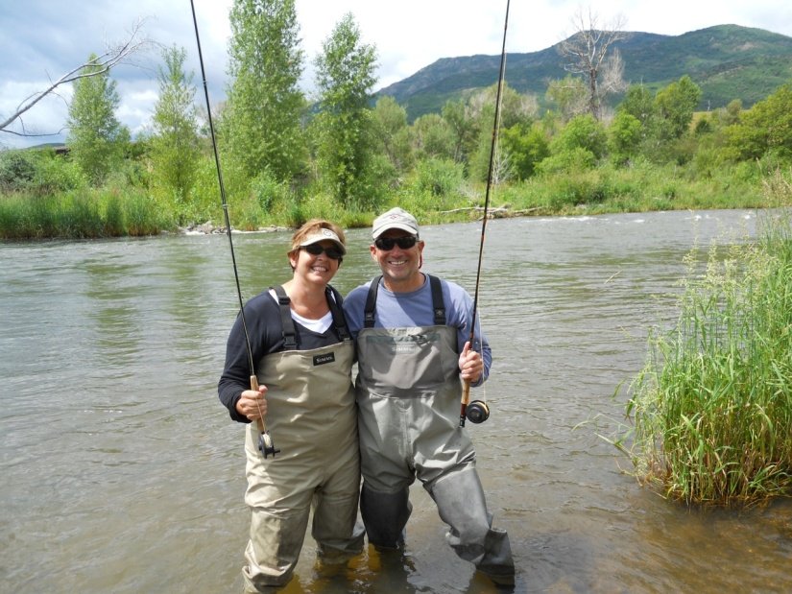
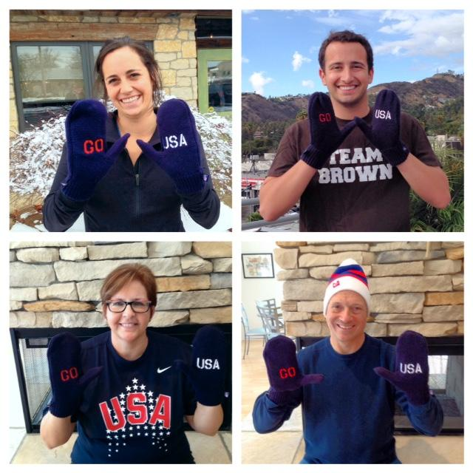
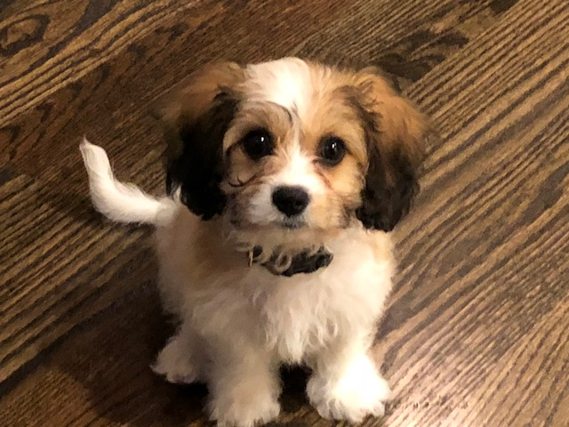
My family:
Amy- lives and works
In Chicago
Eric- lives and works
In Los Angeles
My new puppy, Scout - we got her this summer. She was named after my favorite character in a book - Scout Finch from To Kill a Mockingbird
Mrs. Rosengard
Mr. Rosengard
What is your family like?

Slide 3
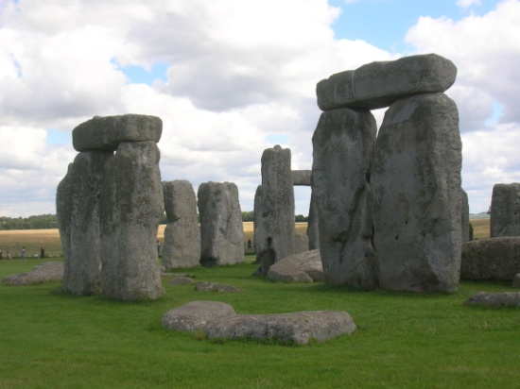
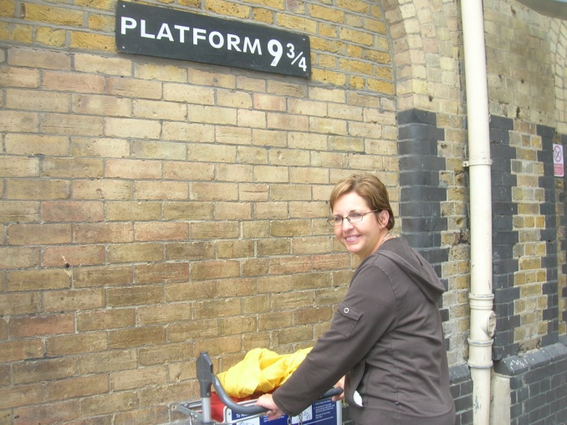
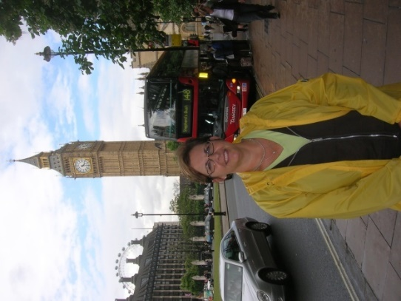
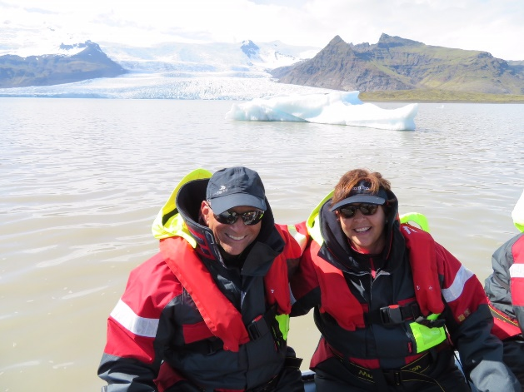
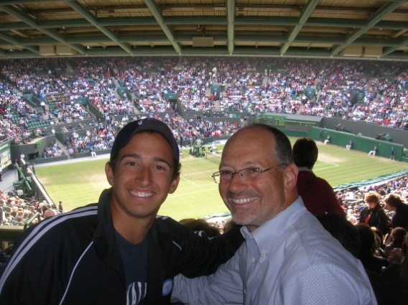
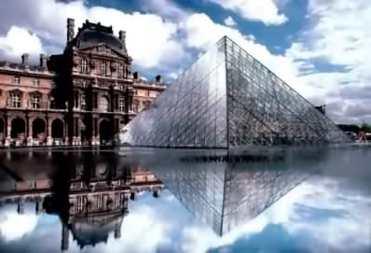
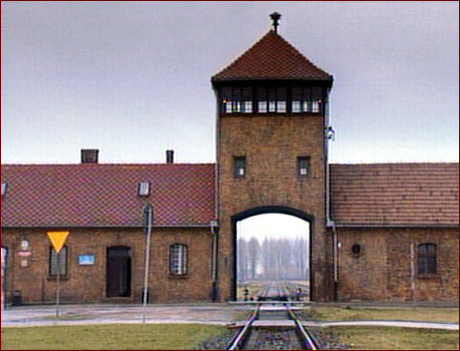
TRAVEL is my passion!
London –my favorite city in Europe!
Stonehenge
London
Wimbledon
-tennis
Paris-my favorite museum-
The Louvre
Iceland
Auschwitz in Poland
Where do you like to go?

Slide 4
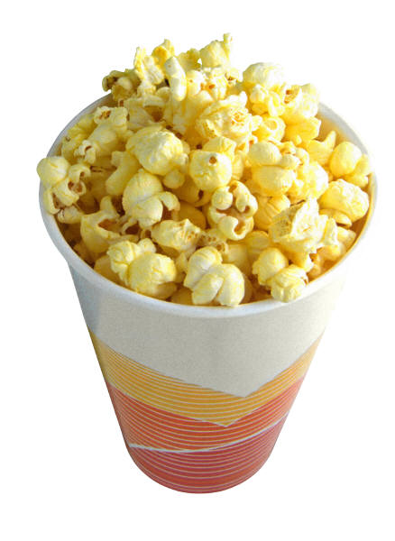
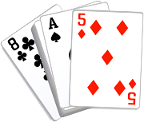
I love to…
READ!
Travel
Root for our teams!
Listen to music (all kinds-
especially country & classic rock)
Walk & Hike
Go to the theatre
Go to movies
Play cards
Go fishing!
What do you like to do?

Slide 5
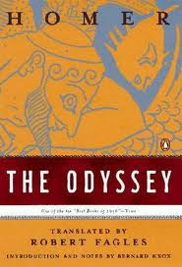
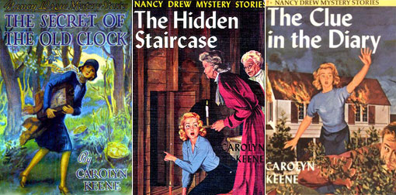
I LOVE to READ!
My favorite book! It helped me
think about some “big” ideas in life!
I loved this book when I was
learning to read – the party in the
tree is great!
What are your favorite books?

Slide 6
Please email me and tell me a little about yourself!

